Slide 1
Introduction to the 20th ISS
ONLINE
Hosted by Tokyo University of Agriculture
Notes:
Welcome !
In this presentation, we will introduce the 20th International Students Summit organized and hosted by Tokyo University of Agriculture.

Slide 2
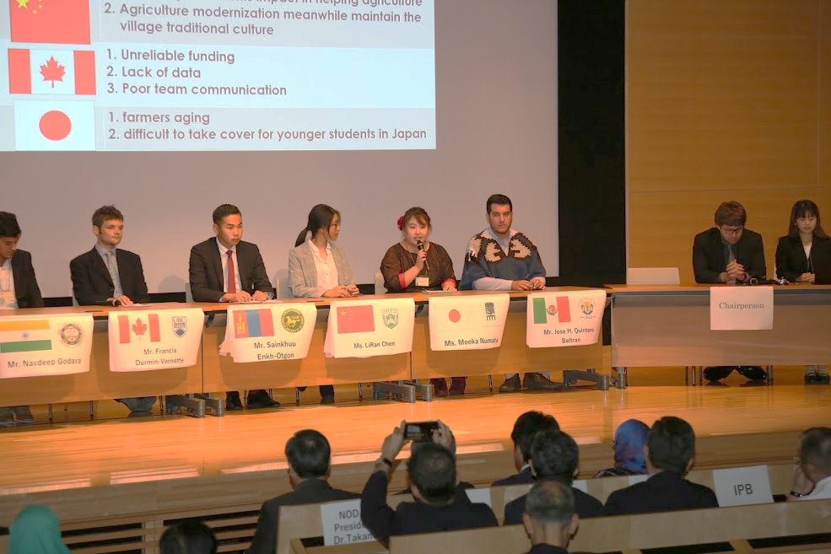
What is International Students Summit (ISS)?
Tokyo NODAI has been hosting the ISS since 2001 to provide an opportunity for students from around the world to gather and exchange views and ideas on food, agricultural, and environmental issues in the world, and to discuss the role to be played by youth for the sustainable livelihood of mankind. This year, the 20th ISS includes the new sub-theme of “Nutrition”, making a total of 5 sub-themes.
Notes:
I brief history of the ISS

Slide 3
Online Program
Due to the COVID-19 pandemic, Tokyo University of Agriculture (Tokyo NODAI) offers the 20th International Students Summit exclusively online.
International Students Summit (ISS)
Sept. 14th ~ Sept. 17th, 2021
Held in the fall, the program is meant to raise
next generation leaders based on the comprehensive
combination of practical learning and leadership experience. Upon successful completion of the program, undergraduate students will be awarded 2 academic credits if they complete all the tasks and actively participate. This program especially encourages participation of undergraduate students.
2 credits
Certificate
Notes:
In contrast to the previous ISSs, this 20th edition faces the same limitations imposed by governments as measures for preventing the spread of the COVID-19.
Therefore, the 20th ISS will be organized exclusively online from September 14th to the 17th .

Slide 4
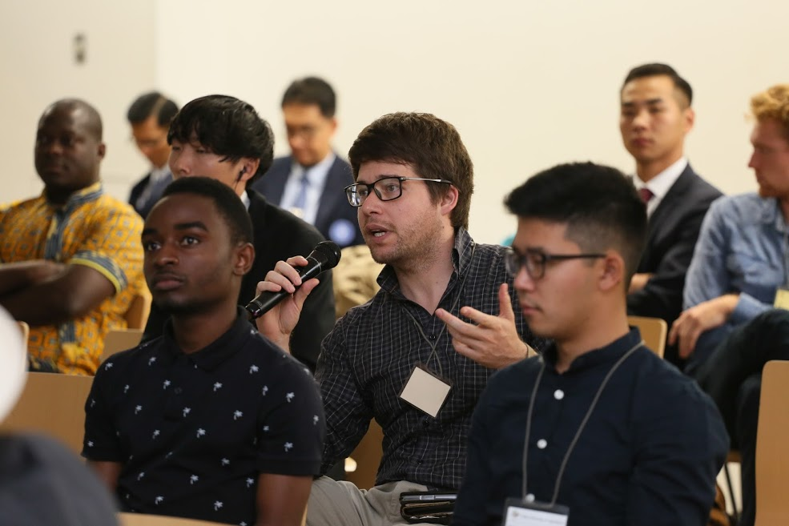
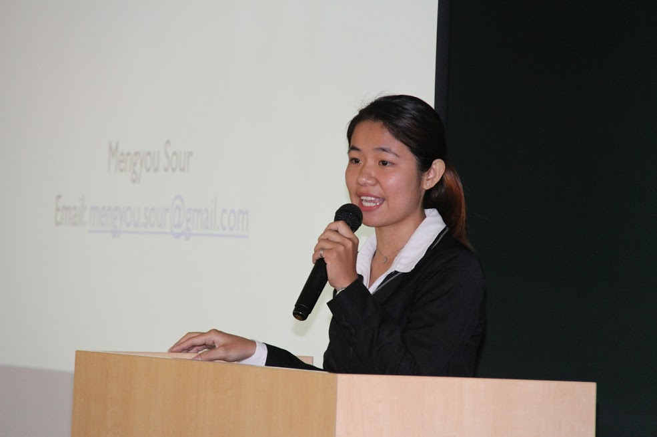
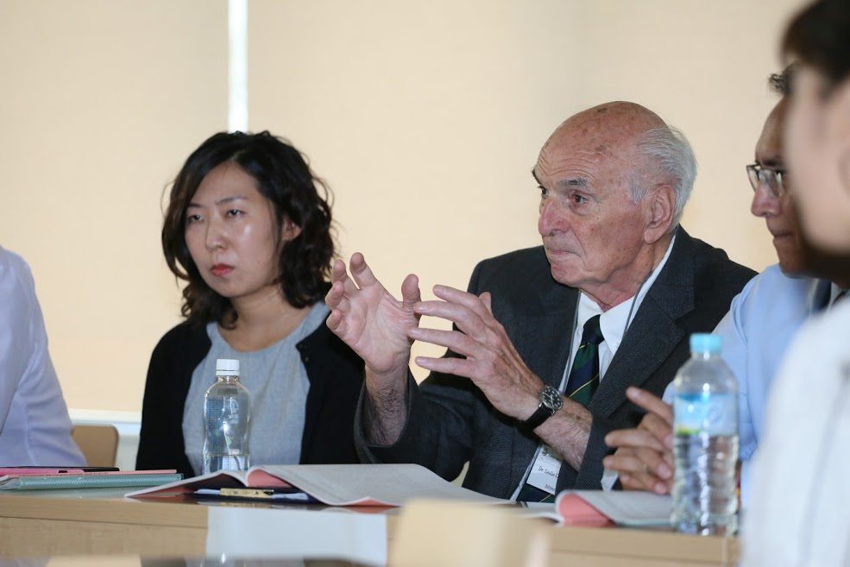
Theme of the 20th ISS 2021:
Linking Actions, Research and Education in Agriculture Value Chains to Achieve Environmental, Social and Economic Sustainability
Notes:
At the end of the 19th ISS, the theme of …. Has been decided. Student discussions and exchanges during the 20th ISS will be on this theme

Slide 5
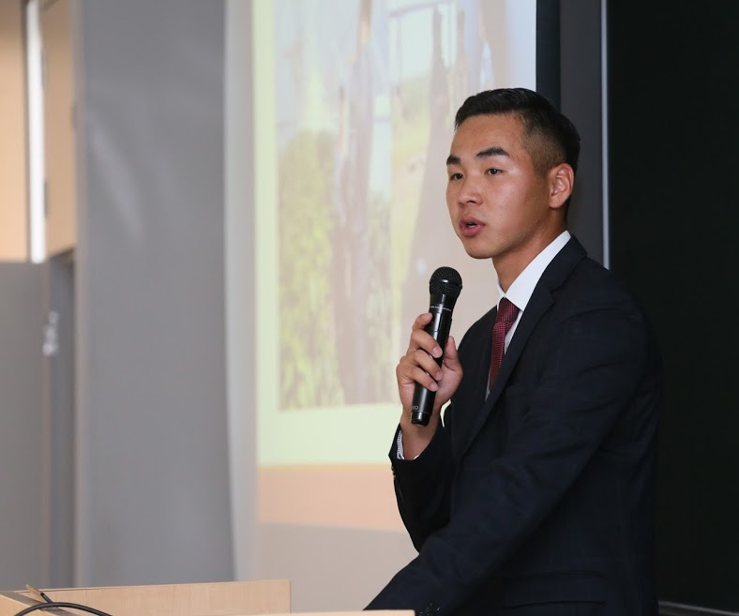
Who are the presenters?
Students representing their respective universities by presenting their current research, project, or other initiatives related to the 20th ISS theme to have meaningful discussions with other students and scholars from around the world.
Two (02) students (Representatives) will be carefully selected by each university as presenters.
(A Presenter)

Slide 6
Requirements to get certificate accreditation for the 20th ISS
All participant students of the 20th ISS will get certifications provided they have completed tasks including, but not limited to:
Submission of all required documents (e.g., 2-3 pages A4-size extended abstract, self-introduction PowerPoint and presentation video)
Watch of all uploaded on-demand presentation videos
Attendance of the Pre-Summit on July 17
Attendance of the online symposium on the 130th anniversary of Tokyo NODAI on Sept. 14
Attendance of the session of assigned group during the ISS week on Sept.15 or 16
Active participation into discussions through meaningful comments and questions
Note: Undergraduate students can get two academic credits from Tokyo NODAI if they have fulfilled all requirements.

Slide 7
Special features of the online 20th ISS
As the 20th ISS will be held online, the following changes will be implemented:
Registration of representatives through Google Forms
Submission of extended Abstracts (2-3 pages Word File, A4 size)
Prepare a self-introduction PowerPoint
Submit pre-recorded presentations as mp4 files
Organization of a Pre-Summit
Extended Abstracts in PDF format and published open-access

Slide 8
Timeline until ISS 2021
For Students
Watching group presentations
June 14
July 3
July 17-18
August 16
By Sept. 13
Sept. 14-17
Deadline for online registration and submission of Abstracts (2-3 pages)
Selected representatives assigned to session groups and get comments on Abstracts
Participation to the online Pre-Summit
Submission of revised Abstracts and upload of video presentations (mp4 format)
Attending the 20th ISS online
For Universities / Advisors
June
July
August
Sept.
Application form and abstract due
Confirmation of list of participants
Final abstracts and presentation videos due
20th ISS
List of selected representatives and their faculty advisors sent to Tokyo NODAI by partner universities by June 7.
Tokyo NODAI confirms the list of selected representatives to partner universities via e-mail.
Representatives and Advisors are invited to the 20th ISS

Slide 9
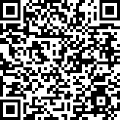
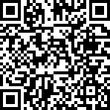
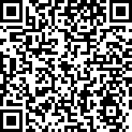
Useful links
Registration Form to 20th ISS
20th ISS webpage
https://www.nodai.ac.jp/english/ip/international-students-summit/
How to record my presentation in mp4 format
https://docs.google.com/forms/d/e/1FAIpQLSeyiVJxkqf9KgOUofgOz443F0ZCd_kNVRpiJdNC4onjdznGaA/viewform
https://nutsandboltsspeedtraining.com/powerpoint-tutorials/convert-powerpoint-to-video/

Slide 10
Structure of the 20th ISS
Day 4
Day 3
Day 1
Day 2
14
15
16
17
Opening and 130th Tokyo NODAI Anniversary symposium
Parallel Sessions
Parallel Sessions
Awarding and Closing
Next ISS theme
Feedback on students / Advisors experiences of the online ISS and closing remarks from Tokyo NODAI
The best presentations will be awarded.
Presenters present in their assigned session group. Another session on a different theme will be held in parallel at the same time.
After parallel sessions, presenters will stick post-it notes on an online whiteboard sharing the common issues and possible solutions found in their presentations.
Based on the post-it notes from all groups, the next ISS theme will be decided and notified to all partners universities later on.
Students and partner universities are invited to the opening ceremony and to attend the symposium on the 130th anniversary of Tokyo NODAI.

Slide 11
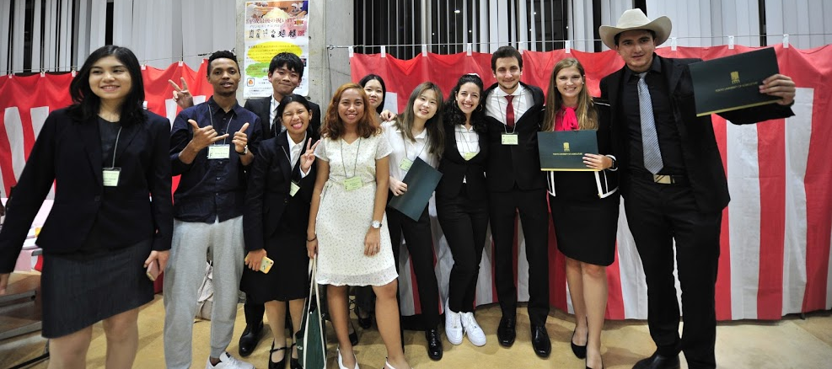
We are looking forward to receiving your application!
Should you have any questions, please email (isf@nodai.ac.jp)
Tokyo University of Agriculture

